Slide 1
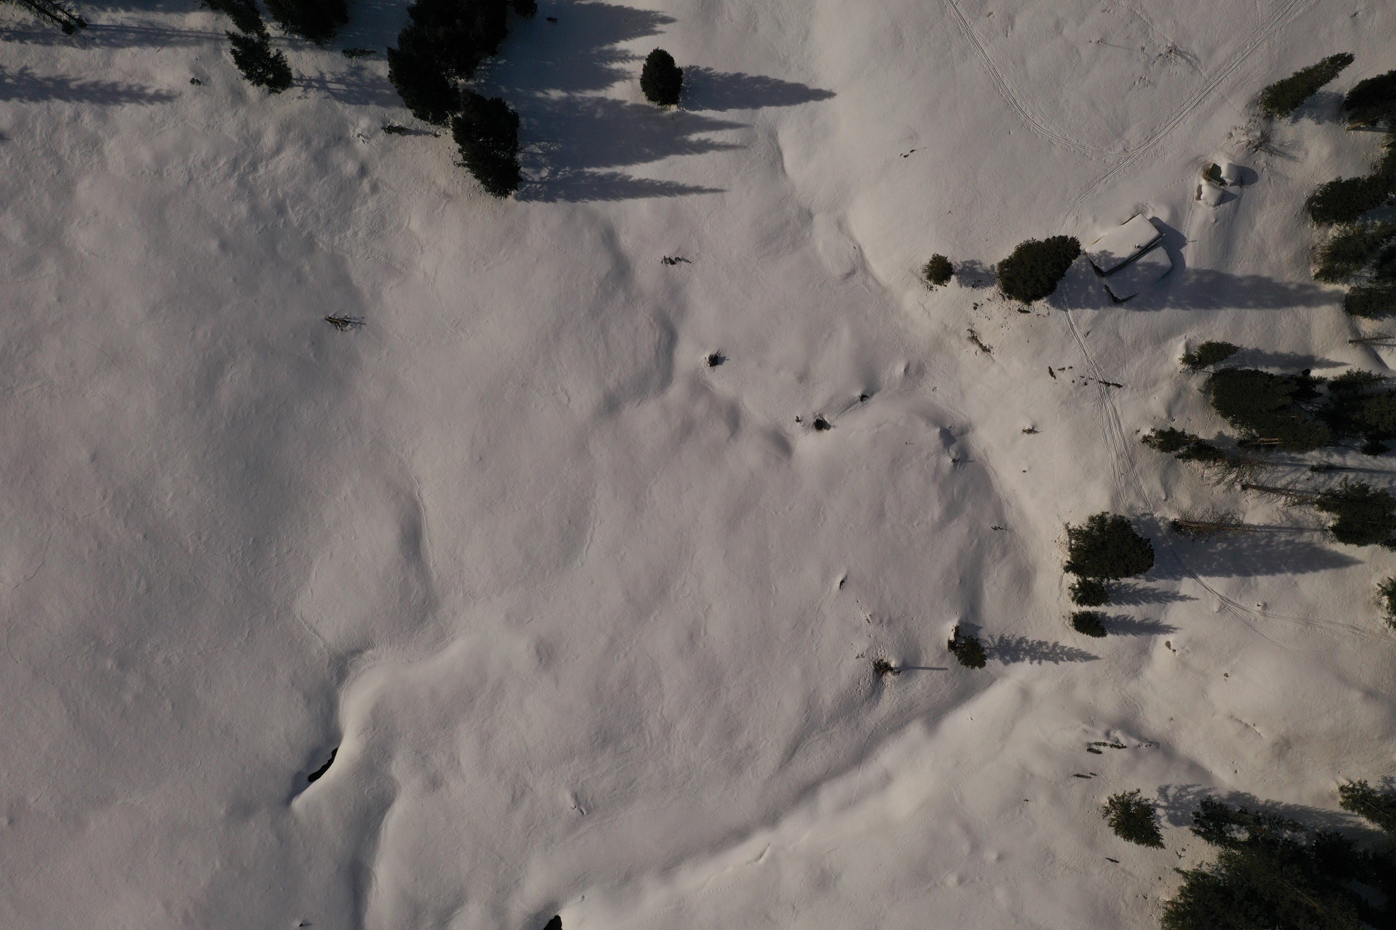
BIOL697: Remote Sensing of Ecological Systems
“Spring” 2024

Slide 2
Introductions

Slide 3
Strategies for Success
Resources?
Read the Syllabus Closely
Take Charge of Your Own Learning
Manage Your Frustration
Use Your Resources
Others?
Other faculty:
Phil Crossley - Geography – RS
Micah Russel – Wetland RS
Jonathan Coop – Forest & Fire
Classmates - !!
ESRI.com trainings / resources
QGIS Resources in Canvas
YouTube(!!)
Me

Slide 4
Strategies for Remote Learning
Remove distraction
Note-taking
(re)Watch recordings at your own pace

Slide 5
The order of the week (and the next 5):
Asynchronous:
Synchronous (Mon. 6:30 - 8pm)
Pre-recorded lecture/video
Pre-class reading
Reflection Assignment (due Sundays)
Comprehension Quiz (due Mondays)
Discussion (45 min)
Break (5 min)
Interactive (40 min)

Slide 6
Independent Project (weeks 7-10)
Related to your research!
Manageable
Incorporates concepts from the course
Wanna brainstorm? Let’s chat.

Slide 7
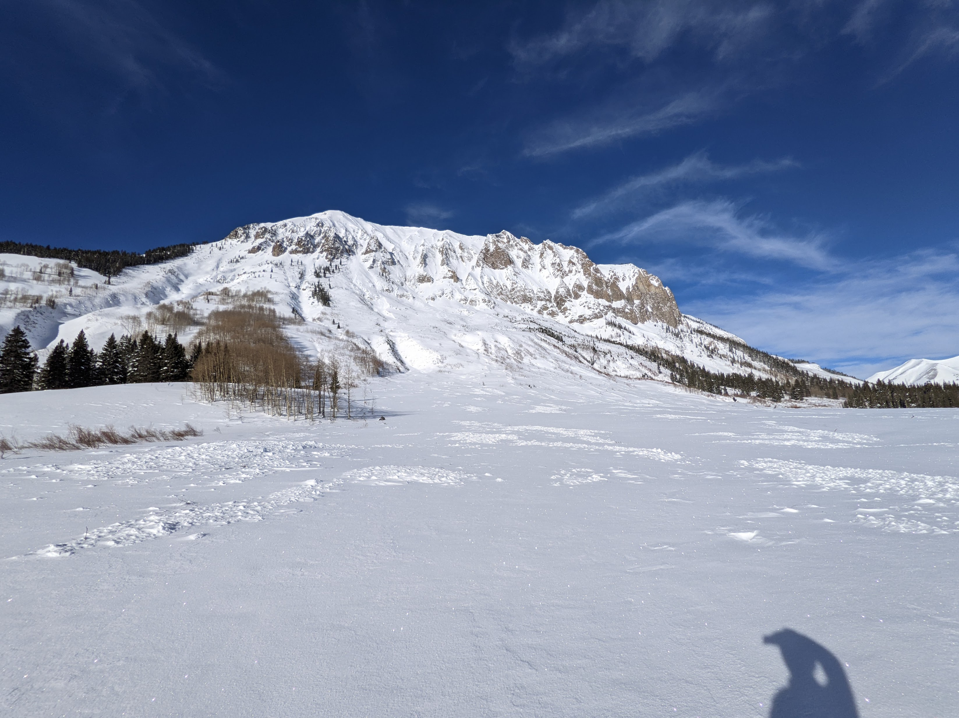
Optional Field Trip to Gothic – March 2nd (or 9th)

Slide 8
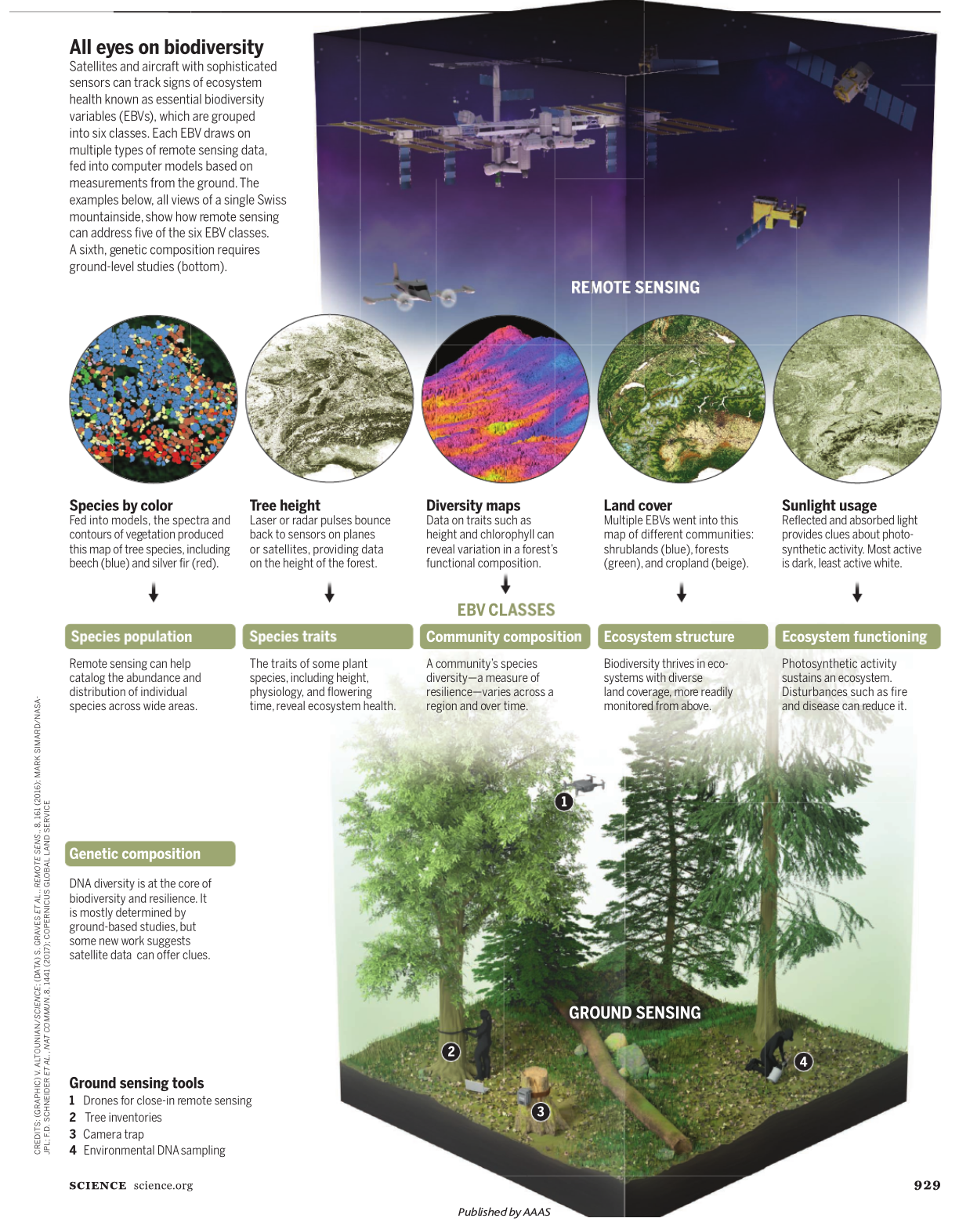
Discussion Questions for Week 1
How is Remote Sensing changing ecology? What about conservation resource management?
What is the promise?
What is the peril? What outcomes do we want to avoid?
How do we embrace the promise and avoid the peril?

Slide 9
5 Minute Break

Slide 10
Software Demo
Intro to the class GitHub:
Intro to QGIS

Slide 11
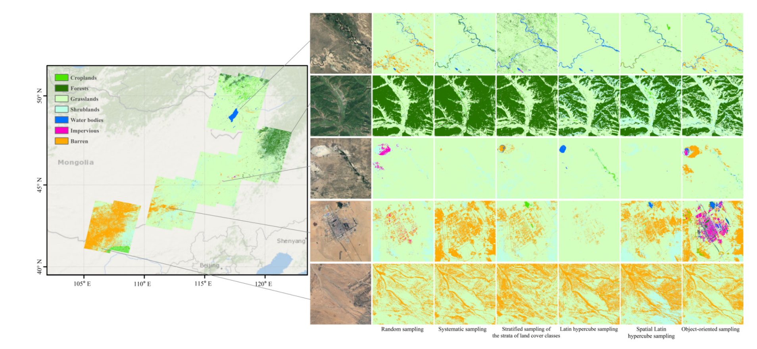
Next Week: Study Design!
Paper: Li et al.
Recorded Lecture
Tuesday b/c MLK Holiday
Comprehension Quiz due Tuesday

